Slide 2
dreamstime.com

Slide 3
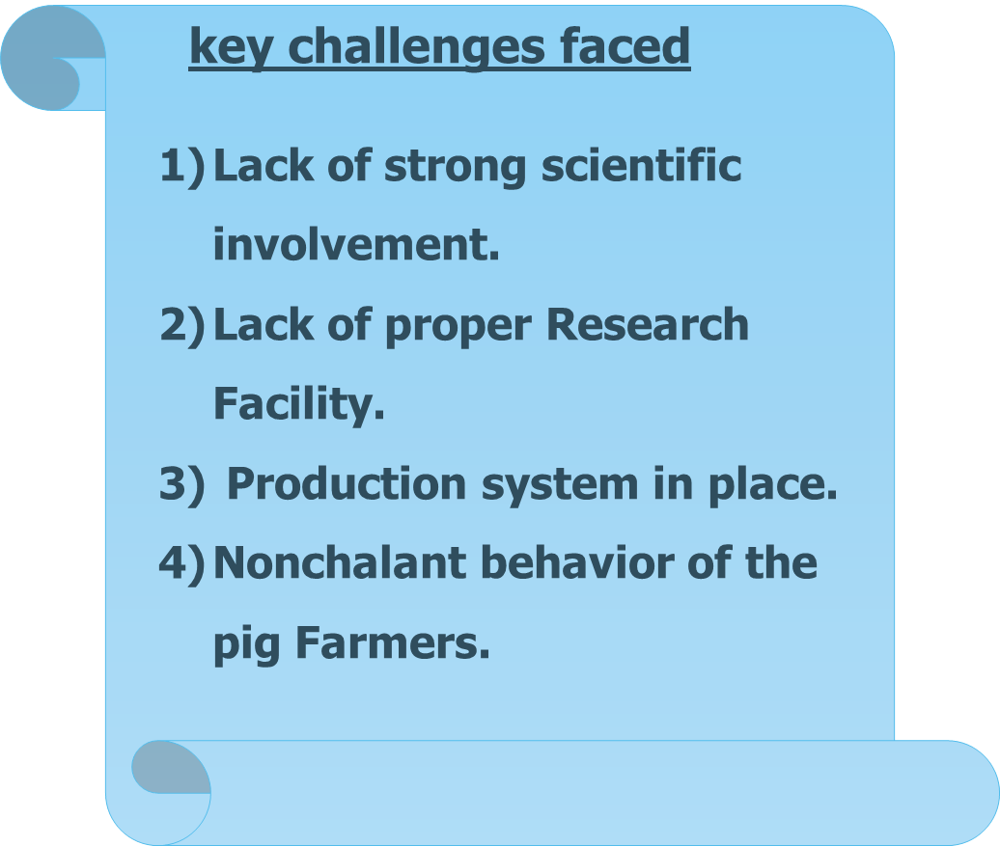
ASFV Cameroon: what's known and key challenges
What's known
Molecular characterisation
1. Genotype I
2.Genotype Ia and Ib
3. Sero-group I
4. Four variants with 6,19,20 and 21
5. Single GGAATATATA repeat
Epidemiological studies
Transmission cycle

Slide 4
ASFV Cameroon: My vision and expectations from GARA
My expectations
GARA
2023
Brainstorming
International collaboration
Create sub research groups
Encourage ASFV research
WGS from all breeds
Assist in control of ASFV
Vaccine development
Vision for the next 5 – 10 years

Slide 5
Toward a multi-epitope, filamentous phage-based vaccine against the African swine fever virus
Ebanja Joseph Ebwanga. PhD
KU Leuven, Belgium

Slide 6
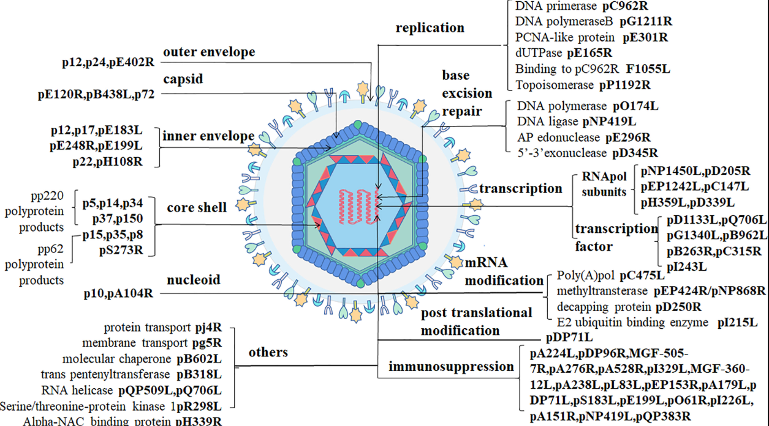
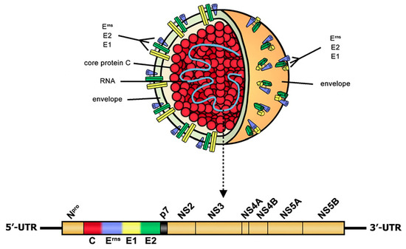
I will try something else
Fan et al.,2021
Wang et al.,2021
Classical swine fever virus
African swine fever virus

Slide 7
ASFV: The search for alternatives
Simple genome
Complex genome
Too many genes
Fewer genes
Easily attenuated
Attenuation
ASFV
Correlates of protection
Correlates of protection
Vaccines or antivirals
No vaccine or no antiviral
Different strategies for a vaccine development
NO protection

Slide 8
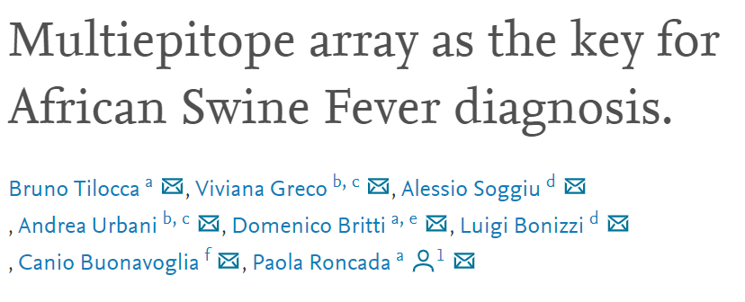
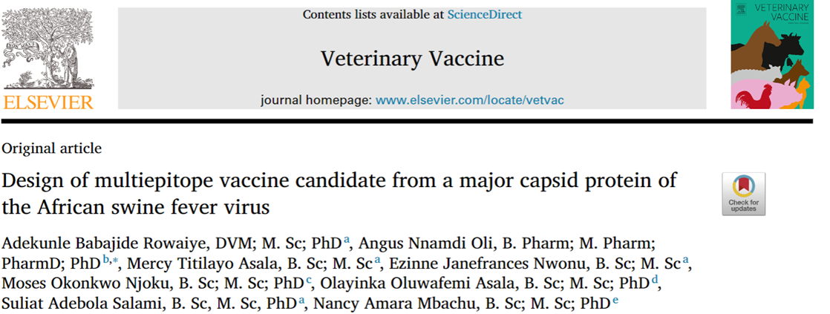
ASFV: Immunoinformatics + phage display
Knowledge from Literature
Immunoinformatics + phage display
Game changer
CD8⁺ T cells
Protection
Antibody protection
Immunoinformatics
Prediction of B and T cell
epitopes
Passive
transfer
Maternal antibodies
Neutralizing
antibodies
+
Phage display
M13 filamentous phages
Involved in protection

Slide 9
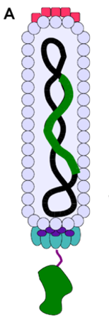
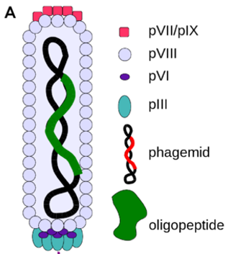
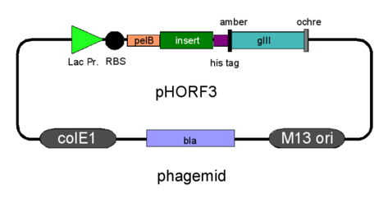
M13 filamentous phage
=

Slide 10
ASFV: The Project
B and T cell epitopes prediction
Diagnostic tool
Cloned for Bacterial protein expression
In vitro trials
Insilico analysis
Cloned for phage display
In vivo trials
Antigenicity
Stability
Structural prediction
Codon harmonization
Cytokine profiles
etc.

Slide 11
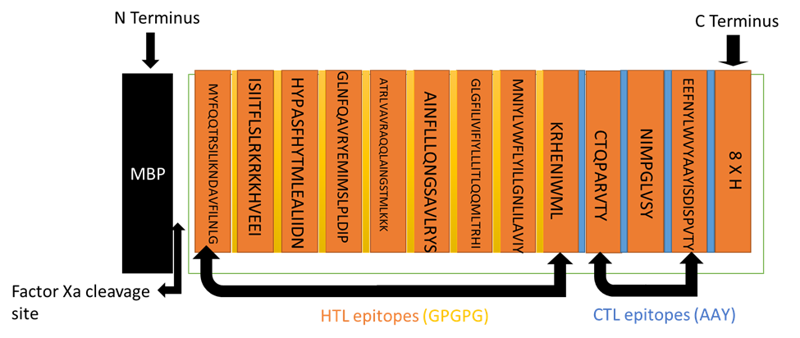
Some Results: B and T cell M13 filamentous phage display project
AAs= 275
Mw = 30.2 kDa
Antigenicity = 0.5988
Stability = 35
Structure
41% = exposed,
24% = medium
34% = buried
Cloned into Pmal-c4 protein expression vector by Genscript
Cloned into the phasmid

Slide 12
Collaboration
Contact
Prof Jan Paeshuyse
Ku Leuven
jan.paeshuyse@kuleuven.be
Prof Ghogomu
University of Buea
stephen.ghogomu@ubuea.cm
Ebanja Joseph Ebwanga. PhD
Poulpharm bvba
ebanjajoeph@gmail.com
PhD student(s)

Slide 13
Thanks

